Slide 1
Program Structures

Slide 2
Building a Java Clss
Previous lab and homework demonstrated a simple Java application. public class HelloWorld { public static void main(String[] args) { System.out.println(“Hello World”); } }
Be familiar with the basic components of this sample. All applications will have this framework. Remember: Class names should begin with a capital.

Slide 3
Building a Java Class
Java code generally consists of:
Comments
Variable definitions
e.g.
int aNumber = 1;
boolean isFound = true;
double anotherNumber = 1.50;
String s = “example of a string”;
note the naming conventions
Method definitions
e.g.
the main method in applications public static void main (String[] args) { }
public computeTax();
again note the naming conventions

Slide 4
Building a Java Class
Comments
Single line
// compiler ignores everything to end of line
Multi-line
/* compiler ignores everything in between */
Multi-line (documentation)
/** compiler ignores everything in between */
Used for JavaDoc
Comments do not appear in executable code

Slide 5
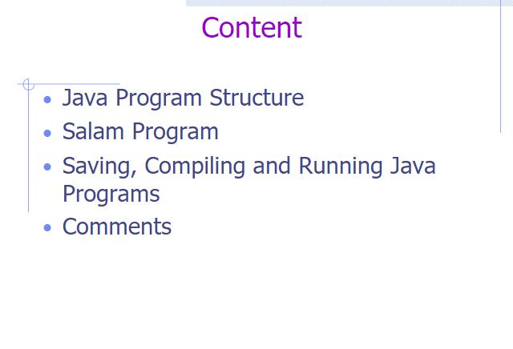
Notes:
https://slideplayer.com/slide/5317078/

Slide 6
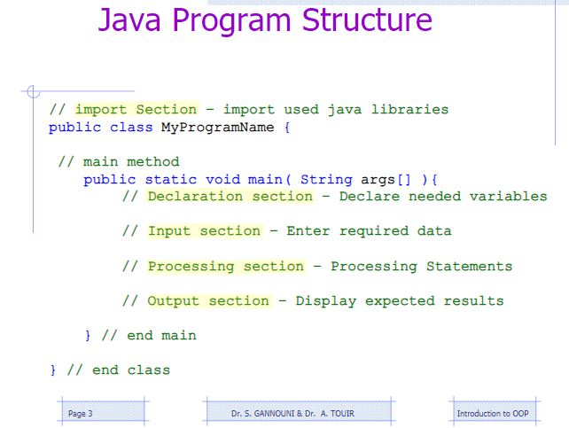

Slide 7
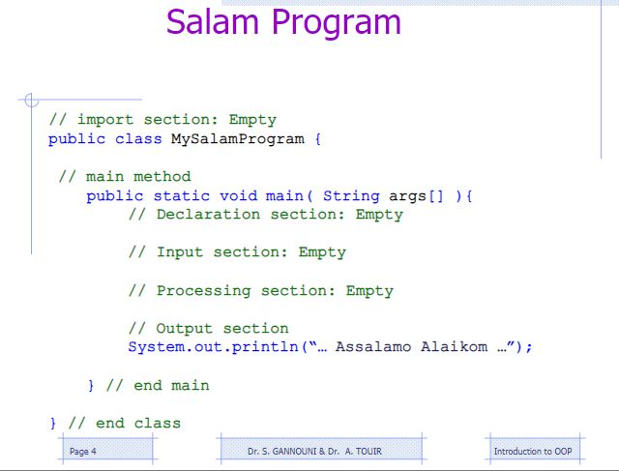

Slide 8
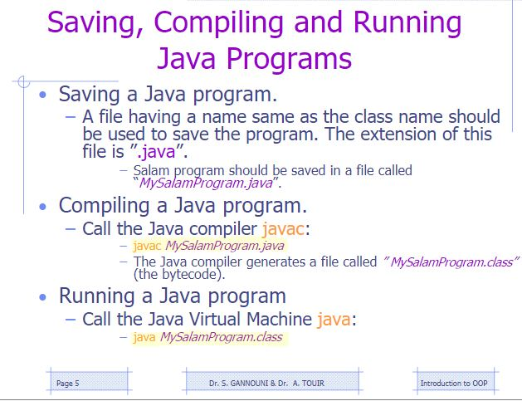

Slide 9
while Loop Flow Chart
int count = 0;
while (count < 100) {
System.out.println("Welcome to Java!");
count++;
}
while (loop-continuation-condition) {
// loop-body;
Statement(s);
}
Notes:
https://cs.nyu.edu/courses/spring07/V22.0101-002/homepage.html

Slide 10
Trace while Loop
animation
Initialize count
int count = 0;
while (count < 2) {
System.out.println("Welcome to Java!");
count++;
}

Slide 11
Trace while Loop, cont.
animation
(count < 2) is true
int count = 0;
while (count < 2) {
System.out.println("Welcome to Java!");
count++;
}

Slide 12
Trace while Loop, cont.
animation
Print Welcome to Java
int count = 0;
while (count < 2) {
System.out.println("Welcome to Java!");
count++;
}

Slide 13
Trace while Loop, cont.
animation
Increase count by 1
count is 1 now
int count = 0;
while (count < 2) {
System.out.println("Welcome to Java!");
count++;
}

Slide 14
Trace while Loop, cont.
animation
(count < 2) is still true since count is 1
int count = 0;
while (count < 2) {
System.out.println("Welcome to Java!");
count++;
}

Slide 15
Trace while Loop, cont.
animation
Print Welcome to Java
int count = 0;
while (count < 2) {
System.out.println("Welcome to Java!");
count++;
}

Slide 16
Trace while Loop, cont.
animation
Increase count by 1
count is 2 now
int count = 0;
while (count < 2) {
System.out.println("Welcome to Java!");
count++;
}

Slide 17
Trace while Loop, cont.
animation
(count < 2) is false since count is 2 now
int count = 0;
while (count < 2) {
System.out.println("Welcome to Java!");
count++;
}

Slide 18
Trace while Loop
animation
The loop exits. Execute the next statement after the loop.
int count = 0;
while (count < 2) {
System.out.println("Welcome to Java!");
count++;
}

Slide 19
Caution
Don’t use floating-point values for equality checking in a loop control. Since floating-point values are approximations, using them could result in imprecise counter values and inaccurate results. This example uses int value for data. If a floating-point type value is used for data, (data != 0) may be true even though data is 0.
// data should be zero
double data = Math.pow(Math.sqrt(2), 2) - 2;
if (data == 0)
System.out.println("data is zero");
else
System.out.println("data is not zero");

Slide 20
do-while Loop
do {
// Loop body;
Statement(s);
} while (loop-continuation-condition);

Slide 21
for Loops
for (initial-action; loop-continuation-condition; action-after-each-iteration) {
// loop body;
Statement(s);
}
int i;
for (i = 0; i < 100; i++) {
System.out.println(
"Welcome to Java!");
}

Slide 22
Trace for Loop
animation
Declare i
int i;
for (i = 0; i < 2; i++) {
System.out.println(
"Welcome to Java!");
}

Slide 23
Trace for Loop, cont.
animation
Execute initializer
i is now 0
int i;
for (i = 0; i < 2; i++) {
System.out.println(
"Welcome to Java!");
}

Slide 24
Trace for Loop, cont.
animation
(i < 2) is true
since i is 0
int i;
for (i = 0; i < 2; i++) {
System.out.println( "Welcome to Java!");
}

Slide 25
Trace for Loop, cont.
animation
Print Welcome to Java
int i;
for (i = 0; i < 2; i++) {
System.out.println("Welcome to Java!");
}

Slide 26
Trace for Loop, cont.
animation
Execute adjustment statement
i now is 1
int i;
for (i = 0; i < 2; i++) {
System.out.println("Welcome to Java!");
}

Slide 27
Trace for Loop, cont.
animation
(i < 2) is still true
since i is 1
int i;
for (i = 0; i < 2; i++) {
System.out.println("Welcome to Java!");
}

Slide 28
Trace for Loop, cont.
animation
Print Welcome to Java
int i;
for (i = 0; i < 2; i++) {
System.out.println("Welcome to Java!");
}

Slide 29
Trace for Loop, cont.
animation
Execute adjustment statement
i now is 2
int i;
for (i = 0; i < 2; i++) {
System.out.println("Welcome to Java!");
}

Slide 30
Trace for Loop, cont.
animation
(i < 2) is false
since i is 2
int i;
for (i = 0; i < 2; i++) {
System.out.println("Welcome to Java!");
}

Slide 31
Trace for Loop, cont.
animation
Exit the loop. Execute the next statement after the loop
int i;
for (i = 0; i < 2; i++) {
System.out.println("Welcome to Java!");
}

Slide 32
Note
The initial-action in a for loop can be a list of zero or more comma-separated expressions. The action-after-each-iteration in a for loop can be a list of zero or more comma-separated statements. Therefore, the following two for loops are correct. They are rarely used in practice, however.
for (int i = 1; i < 100; System.out.println(i++));
for (int i = 0, j = 0; (i + j < 10); i++, j++) {
// Do something
}

Slide 33
Note
If the loop-continuation-condition in a for loop is omitted, it is implicitly true. Thus the statement given below in (a), which is an infinite loop, is correct. Nevertheless, it is better to use the equivalent loop in (b) to avoid confusion:

Slide 34
Example: Using for Loops
Problem: Write a program that sums a series that starts with 0.01 and ends with 1.0. The numbers in the series will increment by 0.01, as follows: 0.01 + 0.02 + 0.03 and so on.
TestSum

Slide 35
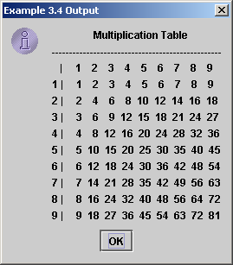
Nested Loops
Problem: Write a program that uses nested for loops to print a multiplication table.
TestMultiplicationTable

Slide 36
Which Loop to Use?
The three forms of loop statements, while, do-while, and for, are expressively equivalent; that is, you can write a loop in any of these three forms. For example, a while loop in (a) in the following figure can always be converted into the following for loop in (b):
A for loop in (a) in the following figure can generally be converted into the following while loop in (b) except in certain special cases (see Review Question 3.19 for one of them):

Slide 37
Recommendations
Use the one that is most intuitive and comfortable for you. In general, a for loop may be used if the number of repetitions is known, as, for example, when you need to print a message 100 times. A while loop may be used if the number of repetitions is not known, as in the case of reading the numbers until the input is 0. A do-while loop can be used to replace a while loop if the loop body has to be executed before testing the continuation condition.

Slide 38
Caution
Adding a semicolon at the end of the for clause before the loop body is a common mistake, as shown below:
Logic Error
for (int i=0; i<10; i++);
{
System.out.println("i is " + i);
}

Slide 39
Caution, cont.
Similarly, the following loop is also wrong:
int i=0;
while (i < 10);
{
System.out.println("i is " + i);
i++;
}
In the case of the do loop, the following semicolon is needed to end the loop.
int i=0;
do {
System.out.println("i is " + i);
i++;
} while (i<10);
Logic Error
Correct

Slide 40
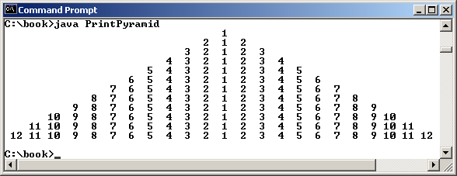
Example: Displaying a Pyramid of Numbers
Problem: Write a program that prompts the user to enter an integer from 1 to 15 and displays a pyramid. For example, if the input integer is 12, the output is shown below.
PrintPyramid
Run

Slide 41
Example: Displaying Prime Numbers
Problem: Write a program that displays the first 50 prime numbers in five lines, each of which contains 10 numbers. An integer greater than 1 is prime if its only positive divisor is 1 or itself. For example, 2, 3, 5, and 7 are prime numbers, but 4, 6, 8, and 9 are not.
Solution: The problem can be broken into the following tasks:
For number = 2, 3, 4, 5, 6, ..., test whether the number is prime.
Determine whether a given number is prime.
Count the prime numbers.
Print each prime number, and print 10 numbers per line.
PrimeNumber
Run

